Slide 1
Refitting models
&
S-factor calculations
13/08/2025 meeting

Slide 2
Refitting models
Optimization problems to reproduce Binding Energy
Check phase-shifts

Slide 3







REMOTE
Approach to fit and conventions
Methodology
outputs
inputs
.txt
.dat
./Boscos.out
Explore visually the Boscos output for differents potential and design the optimization problem.
Incorporate the appropriate method to solve the optimization problem.
RUNNER
run_id
Conventions
 | R esti M emp | R emp M emp | R emp M int | R ws M int
Rc / fm | 2.33951 | 2.35 | 2.35 | 2.39
Mass ħ²/2m | 20.9007964 | 20.9007964 | 20.736 | 20.736
RUNNER
results
LOCAL

Slide 4
Independent central potential depths
197.32705359 1.43996518 20.900796404 * csts: hc,e2,hm
4.002603254 3.016049281 2 1 0 1 * Masses, charges, spins: Ac,Af (in amu),Zc,Zf,iSc,iSf
1 1 * c-f potential: ntypo,Njpo
{Vc:.8f} 2.39 0.68 0.00 2.39 0.68 2.33951 *j,l,Vp,rp,ap,VLS,rls,als,rC
1 * nb of bound states
1 3 1 * bound states: NR,J,l
20000 100 1e-6 * radial mesh:Nru,rmu,eps
1500 3.01 0.01 * Energies: NE,E0,hE
0 * lec 0:E, 10:wf 1st state, 100:phaseshift, 110 bin
Li7comp

Slide 5

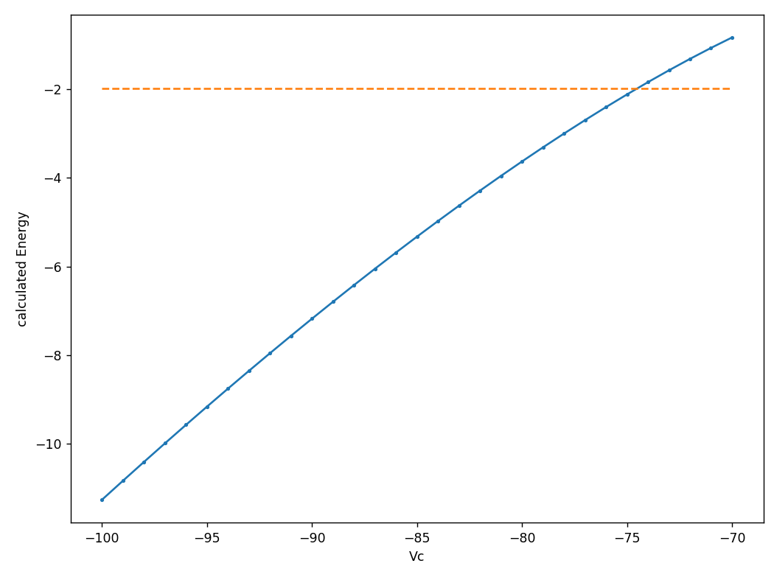
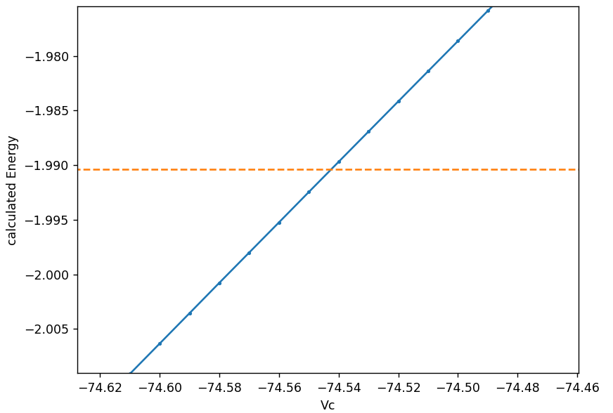
Independent central potential depths: Explore visually
Clearly well-behaved

Slide 6
Independent central potential depths: Optimization
find Vc
s.t. Bg(Vc) = EbG
find Vc
s.t. Be(Vc) = EbE
Root finding
+
f(x) is nearly a line
= Just look to the graph
find x
s.t. f(x)=c

Slide 7
Independent central potential depths: Results
Ground | Vc /MeV | Eb /MeV | ANC fm^-1/2
R esti M emp | -76.2205 | -2.46701 | 3.70477
R emp M emp | -76.2166 | -2.46701 | 3.70470
R emp M int | -75.9211 | -2.46699 | 3.72717
R ws M int | -75.9064 | -2.46699 | 3.72692
Tokim./Exper | -75.031 | -2.46700 | 3.57±0.15
Excited | Vc /MeV | Eb /MeV | ANC fm^-1/2
R esti M emp | -74.5464 | -1.99039 | 3.07993
R emp M emp | -74.5425 | -1.99039 | 3.07988
R emp M int | -74.2493 | -1.99037 | 3.09812
R ws M int | -74.2347 | -1.99040 | 3.09797
Tokim./Exper | -73.392 | -1.99039 | 3.00±0.15

Slide 8
Phase-shifts adjustment
Definitions
We want to
f(Eα) = E_{cm}
→ E_{cm} = μ/mα Eα
Eα = ½ mα (vα)²
Derivation
Transform Ivanovich data to relative energy coordinate.
E_{cm} = ½ μ (v_{rel})²
v_{rel} = vα - vt = vα - 0 = vα
v_{rel} = vα - vt
Use empirical or integer masses according to convention
(v_{rel} )² = (vα)²
Assumptions
(vα)² = 2 Eα / mα
vt = 0
E_{cm} = ½ μ (vα)² = ½ μ 2 Eα / mα = μ/mα Eα

Slide 9
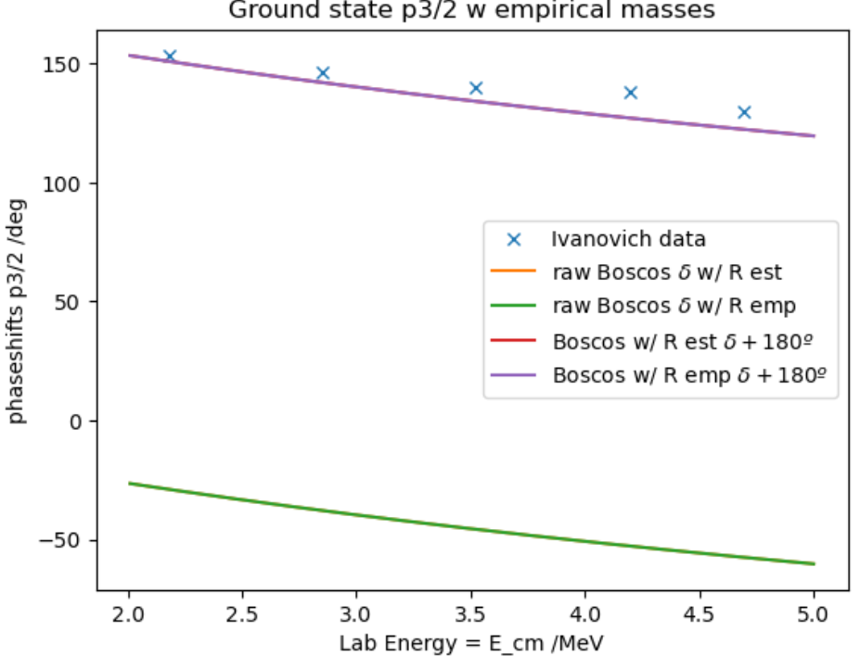
Independent central potential depths: Phase-shifts
There isn’t a big difference between conventions.
(Change in mass more significant than change in radius)
R emp M emp adjust better …
(just by a little)
The goodness of fit correlated with ANC
See the Jupyther Notebook

Slide 10
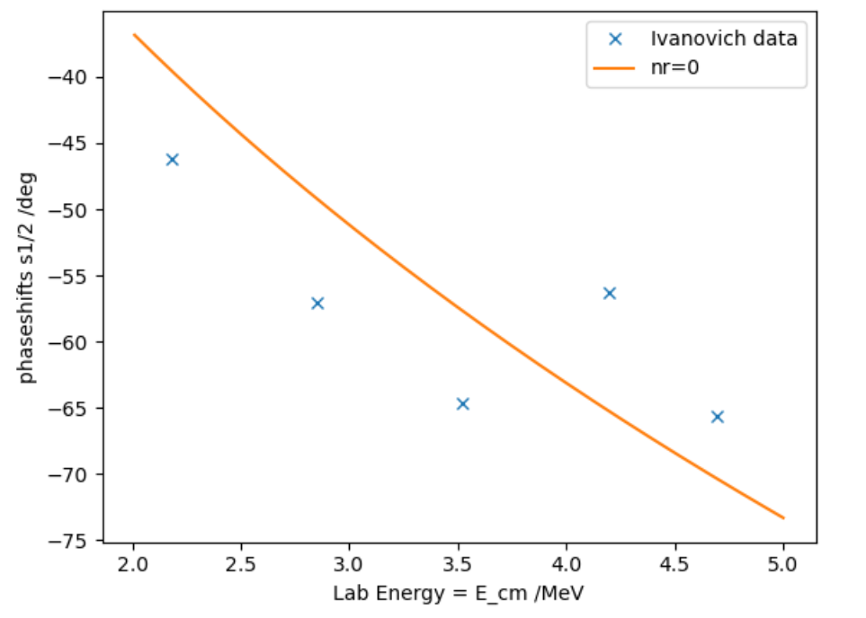
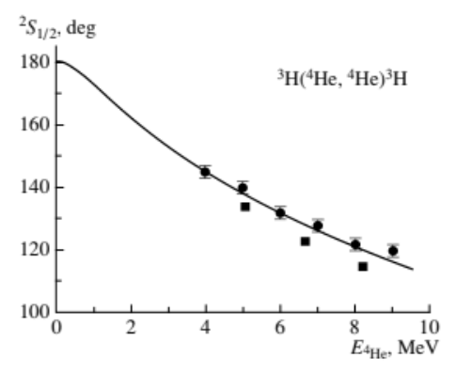
S½ phase-shift by Tokimoto parameters
ref: Dubovichenko

Slide 11
Shared Spin-Orbit Potential
197.32705359 1.43996518 20.736 * csts: hc,e2,hm
4.0 3.0 2 1 0 1 * Masses, charges, spins: Ac,Af (in amu),Zc,Zf,iSc,iSf
1 1 * c-f potential: ntypo,Njpo
{Vc:.8f} 2.39 0.68 {Vso:.8f} 2.39 0.68 2.39 *j,l,Vp,rp,ap,VLS,rls,als,rC
1 * nb of bound states
1 {s:1d} 1 * bound states: NR,J,l
20000 100 1e-6 * radial mesh:Nru,rmu,eps
1500 3.01 0.01 * Energies: NE,E0,hE
0 * lec 0:E, 10:wf 1st state, 100:phaseshift, 110 bin
Li7comp

Slide 12
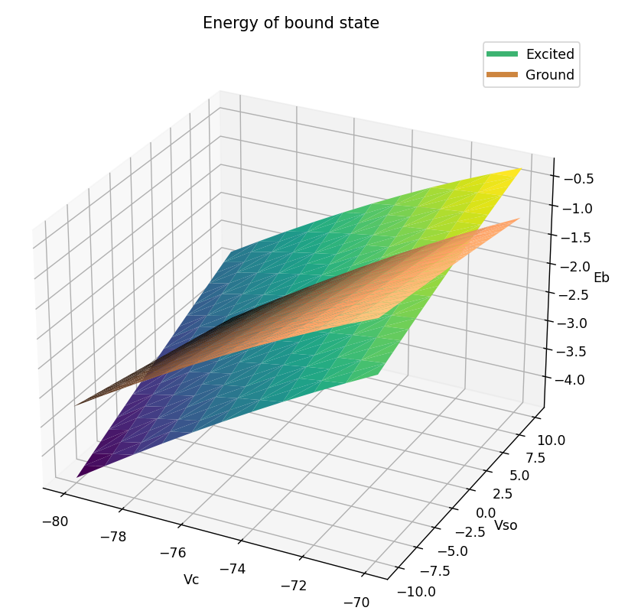
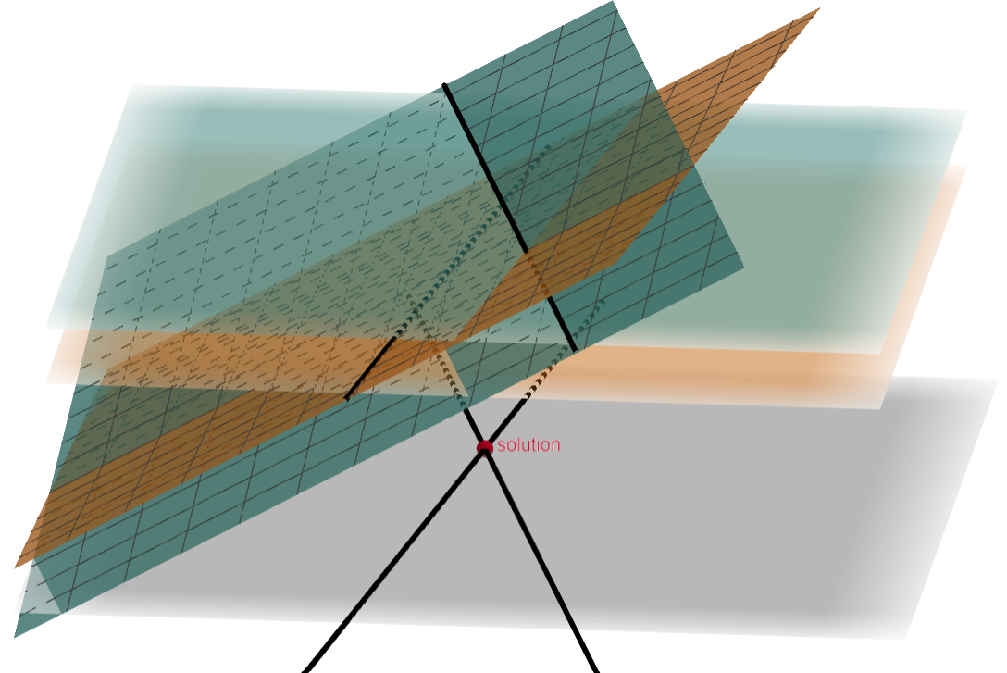
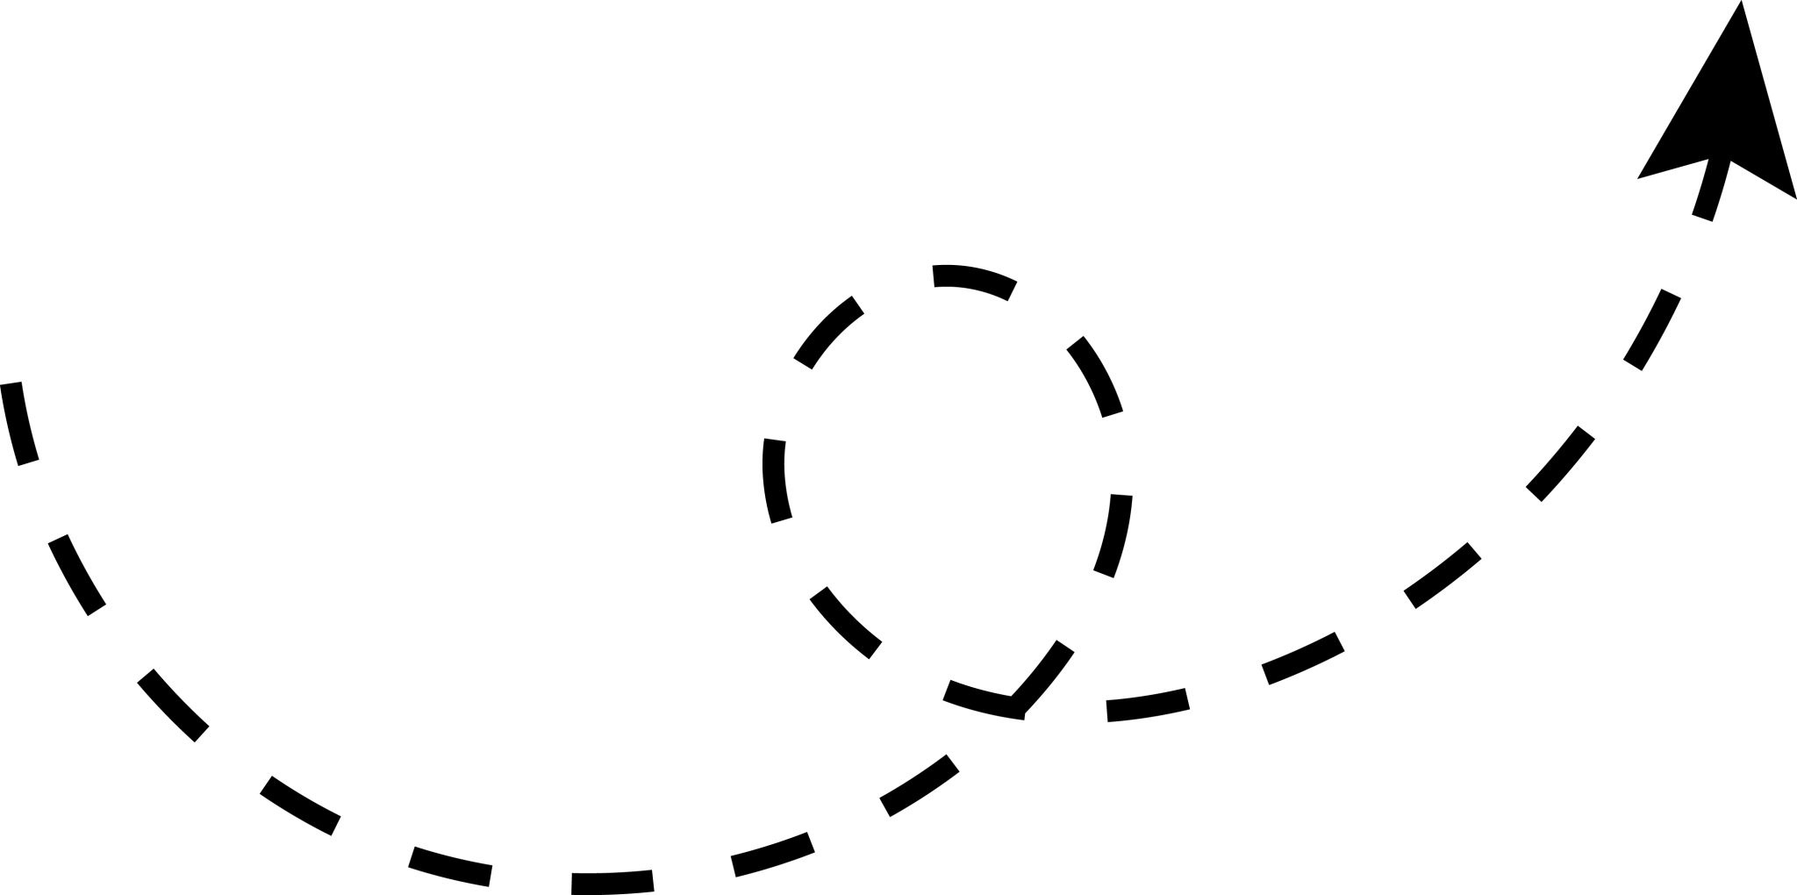
Shared Spin-Orbit Potential: Explore visually
Excited: r² = 0.996 , w^{T} = [0.2795 0.0708]
Ground: r² = 0.997 , w^{T} = [0.2799 -0.0355]

Slide 13
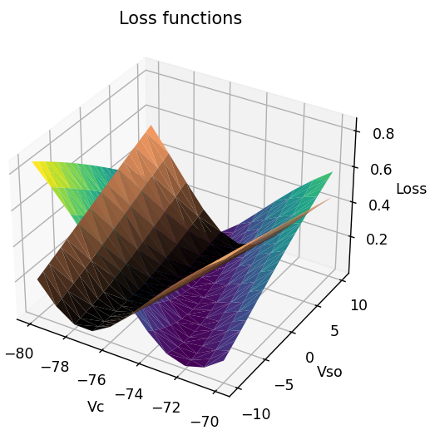
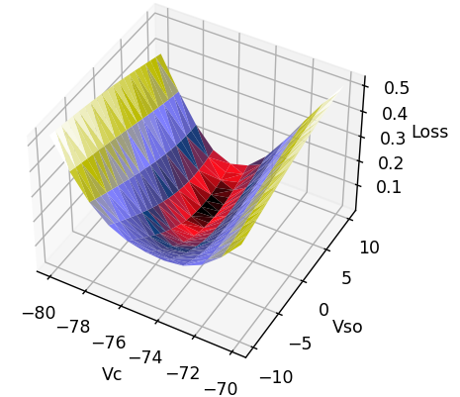
Shared Spin-Orbit Potential: Optimization
L_{G} = ½ ( Bg(Vc, Vso) – EbG )²
L_{E} = ½ ( Be(Vc, Vso) – EbE )²
L = (L_{G}+L_{E})/2 =
(Bg(Vc, Vso)–EbG)²/4+(Be(Vc, Vso)–EbE)²/4
find (Vc,Vso)
s.t. Bg(Vc, Vso) = EbG
&
Be(Vc, Vso) = EbE

Slide 14
Shared Spin-Orbit Potential: Optimization
L = (Bg(Vc, Vso)–EbG)²/4+(Be(Vc, Vso)–EbE)²/4
Strictly convex problem
Just evaluate the Loss, neither gradient or hessian
⇒ Gradient descent
set ղ = 1/λ_{max}
λ_{max} = max{λ(∇²L)}
B_{i}(Vc, Vso) ≈ w_{i}^{T} x – γ_{i}
⇒ ∇²L ≈ (w_{G}w_{G}^{T}+w_{E}w_{E}^{T})/2
⇒ ղ = 12.73
x_{k+1} = x_{k}– ղ∇L(x_{k}) x^{T}=[Vc, Vso]

Slide 15
Shared Spin-Orbit Potential: Results
Ground | Vc /MeV | Vso /MeV | EbG /MeV | EbE /MeV | ANC-G fm^-1/2 | ANC-E fm^-1/2
R esti M emp | -75.6628 | 4.3906 | -2.46702 | -1.99037 | 3.70725 | 3.07617
R emp M emp | -75.6589 | 4.3904 | -2.46701 | -1.99038 | 3.70718 | 3.07613
R emp M int | -75.3642 | 4.3846 | -2.46702 | -1.99037 | 3.72970 | 3.09434
R ws M int | -75.3495 | 4.3848 | -2.46702 | -1.99037 | 3.72945 | 3.09415
Experimental |  |  | -2.46700 | -1.99039 | 3.57±0.15 | 3.00±0.15

Slide 16
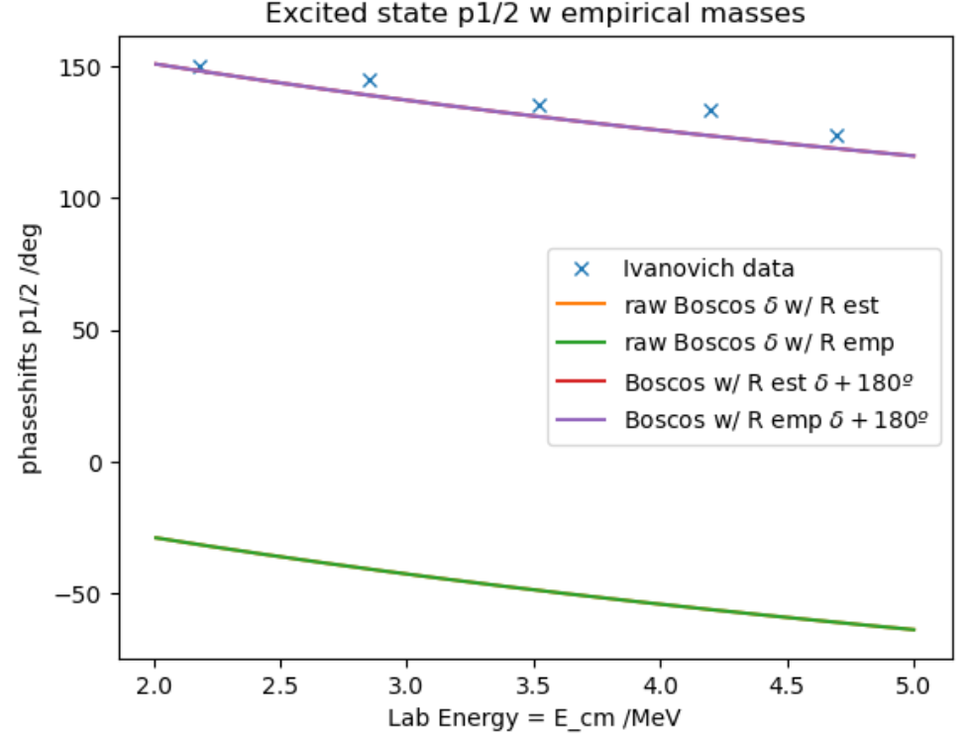
Shared Spin-Orbit Potential: Phase-shifts
QUALITATIVELY IDENTICAL to Independent central potential depths.
Small of interesting differences.
See the Jupyther Notebook

Slide 17
Interesting observation, phase-shift and ANC
For Ground state, the Independent Central Potential fit is closer to Ivanovich data.
3.70470 < 3.70477 < 3.72692 < 3.72717 : IndpC
3.70718 < 3.70725 < 3.72945 < 3.72970 : VcVso
⇒ ANC(IndpC) < ANC(VcVso)
For Excited state, the Spin-Orbit Potential fit is closer to Ivanovich data.
3.07988 < 3.07993 < 3.09717 < 3.09812 : IndpC
3.07613 < 3.07617 < 3.09415 < 3.09434 : VcVso
⇒ ANC(IndpC) > ANC(VcVso)
Again, correlated with ANC.

Slide 18
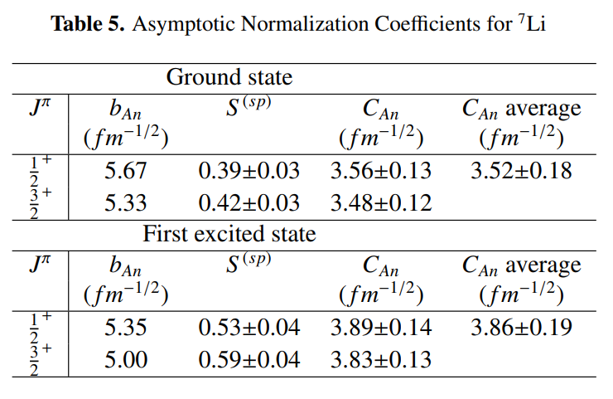
Interesting observation, phase-shift and ANC
2024, J. A. Pérez-Velasco, J. C. Morales-Rivera
2006, S.B. Igamov, R. Yarmukhamedov
Obtained by different conventions and methods:
Ground: 3.71±0.01
Excited: 3.08±0.01

Slide 19
2. S-factor calculations
Use refitted models in Racam.f to calculate S-factor contributions

Slide 20


Radioactive capture
Li7WS_EekX
4.002603254 3.016049281 2 1 * A1,A2,Z1,Z2 (Masses, charges)
1 0 1 1 0 1 1 1 1 *lam,i1,i2,if,li,ji,lf,jf,n0
100 20000 *rmax, Nr
WS
62.74 0 2.39 0.68 74.5425 0 2.39 0.68 2.35 *V_0i,Vsoi,ri,ai,V_0f,Vsof,rf,af,rC
500 0.01 0.01 * Ne, E0, hE
10 *lec: 0 only wf, 10, cross sections
E1 transition from s1/2 to p-waves
Tokimoto’s potential for s-wave

Slide 21
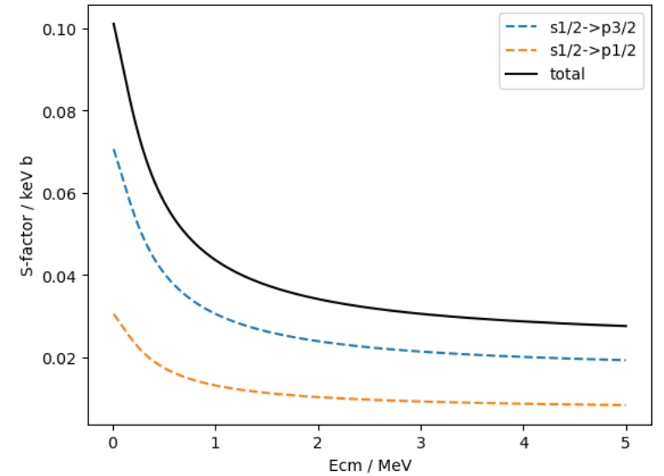
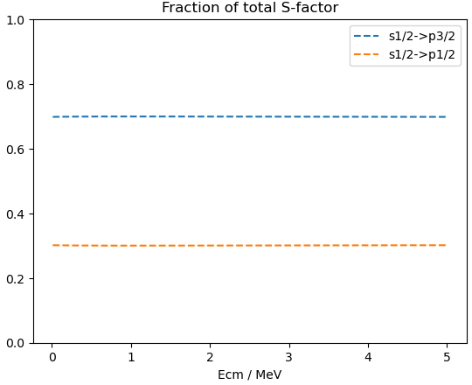
Radioactive capture: Racam.f results
Using:
Independent Central Potentials
R emp M emp convention

Slide 22
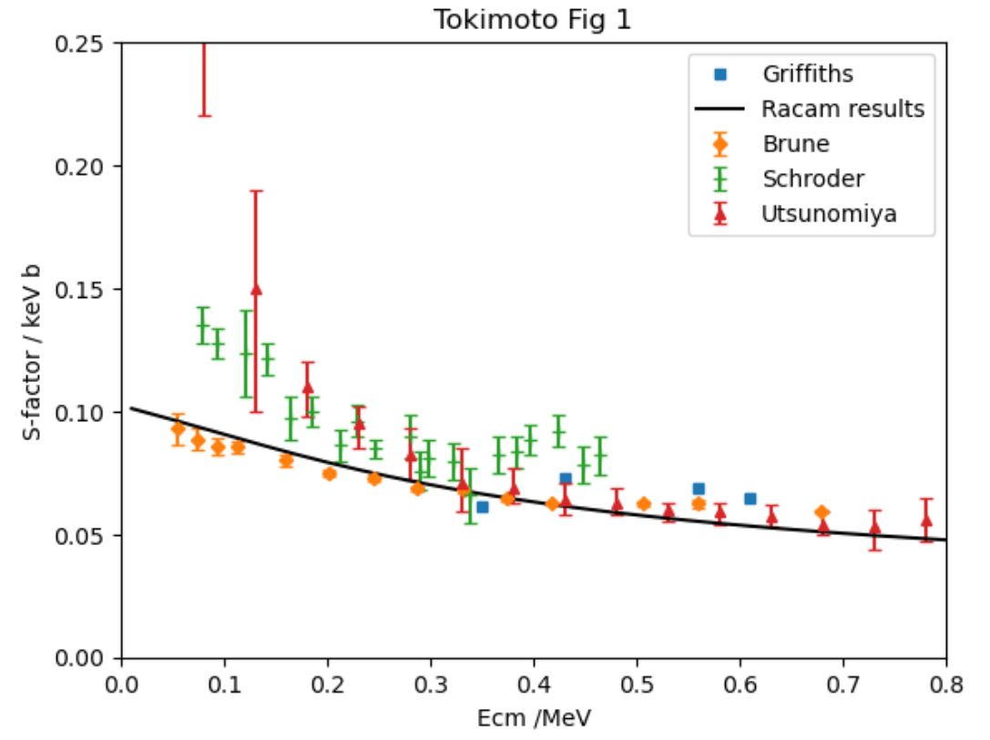
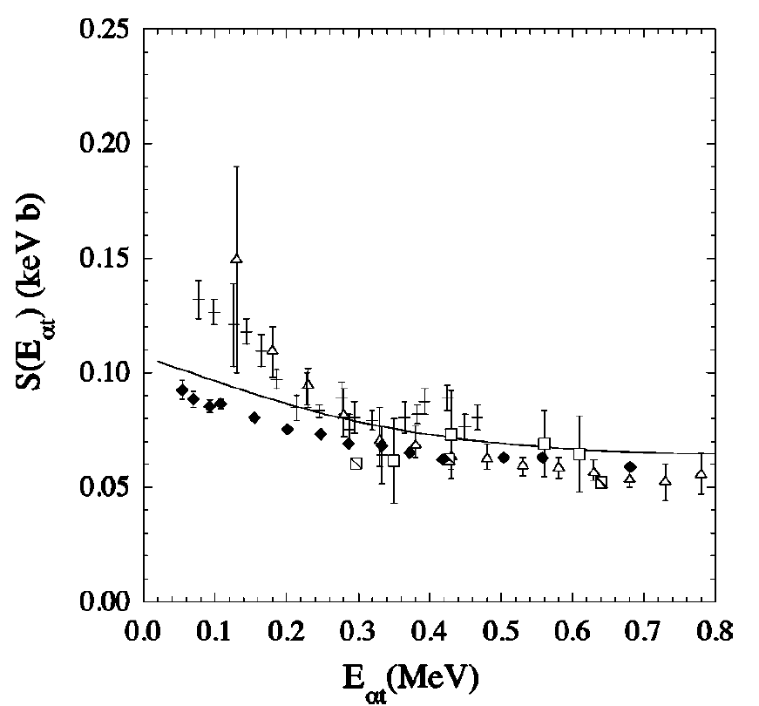
Radioactive capture: Racam.f results
→ Solid line for Tokimoto’s results

Slide 23
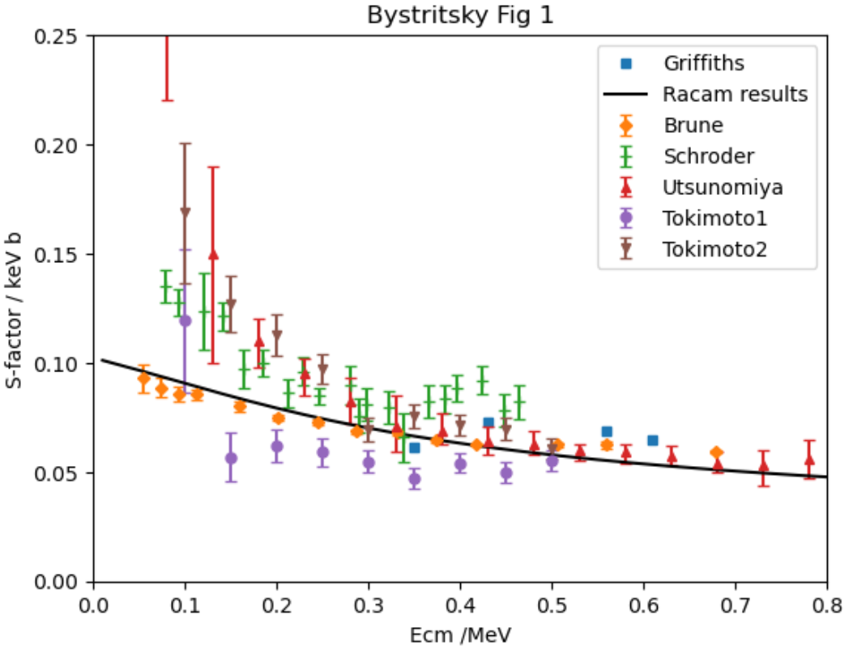
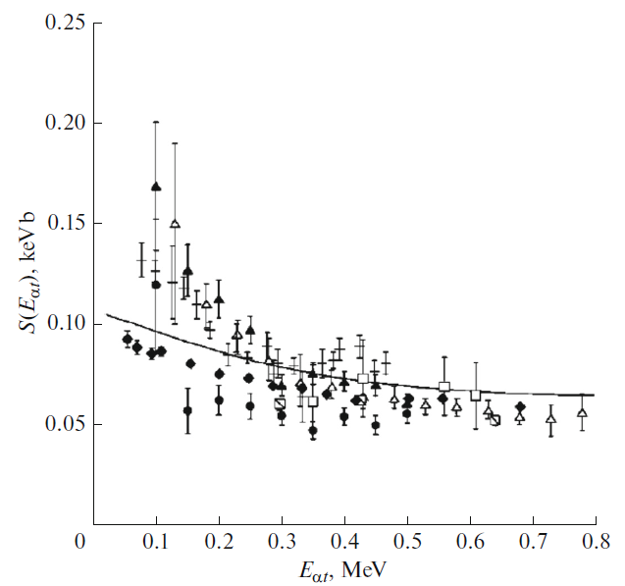
Radioactive capture: Racam.f results
→ Solid line for Tokimoto’s results

Slide 24
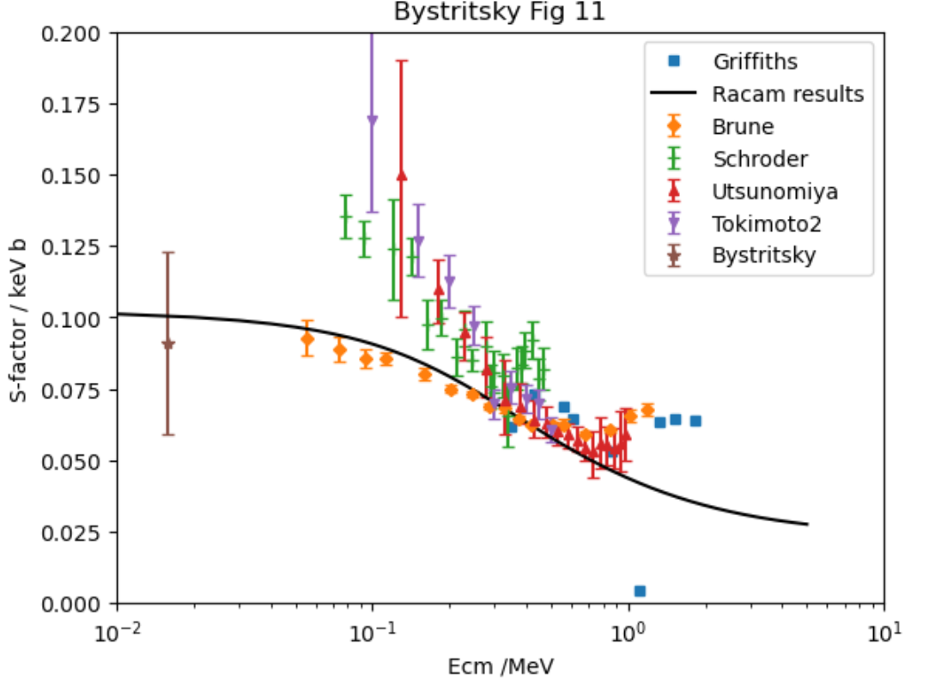
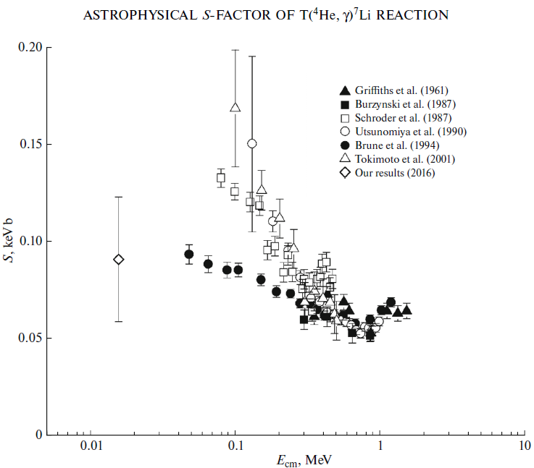
Radioactive capture: Racam.f results

Slide 25
